Slide 1
Class 1: Introduction
MGSC 310
Ben Labaschin

Slide 2
Welcome to MGSC 310!
This is a class about one thing:
data
Specifically learning from data.
you will learn from data
By the end of this class
to teach machines to learn from data
to help businesses to learn from data

Slide 3
Find Your North Star ⭐️
The content in this course may challenge you, bore you, or confuse you.
That is okay.
Find a motivating force early in this class. Here are a few…

Slide 4
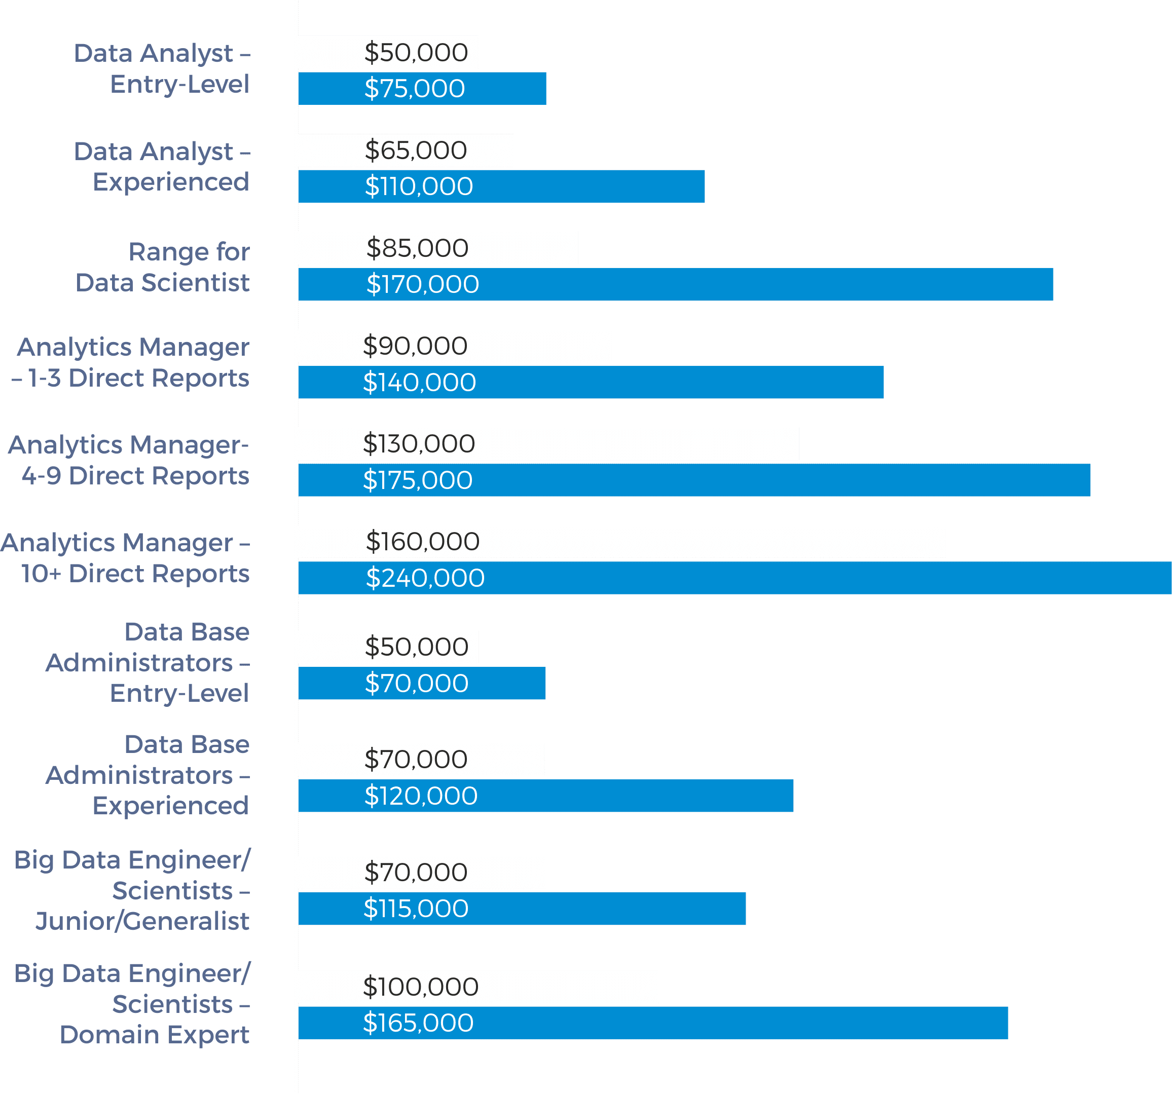
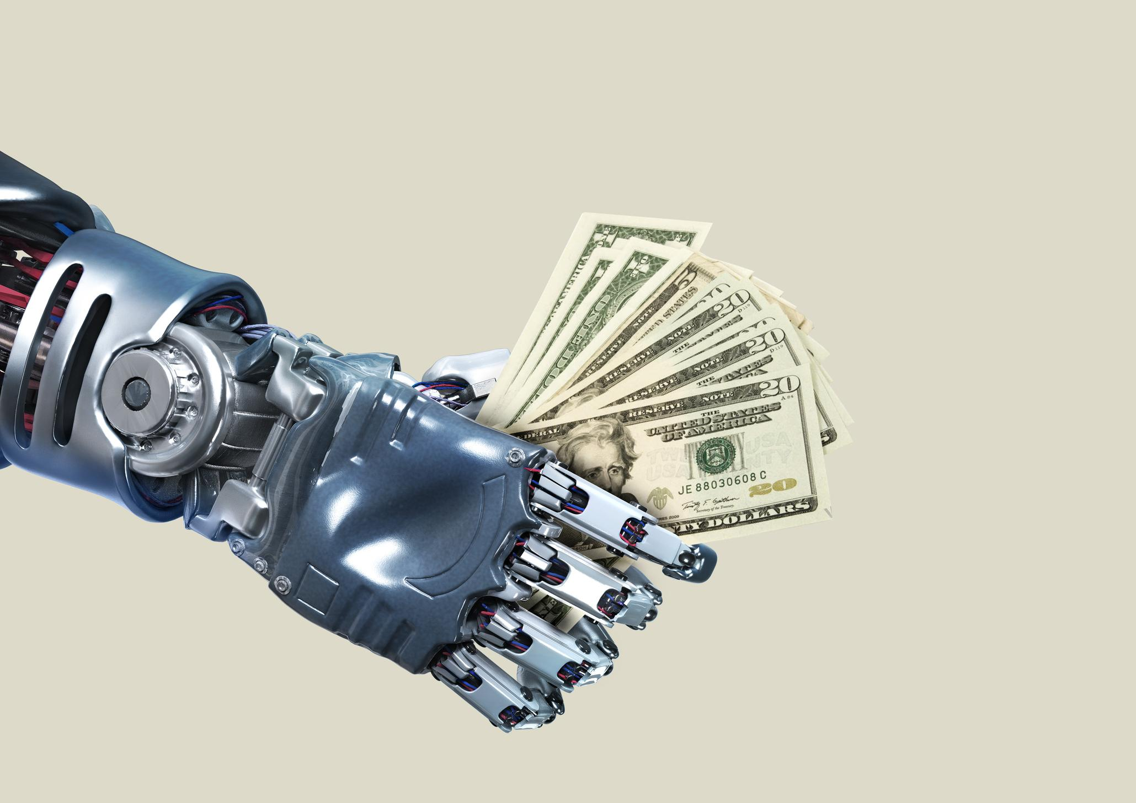
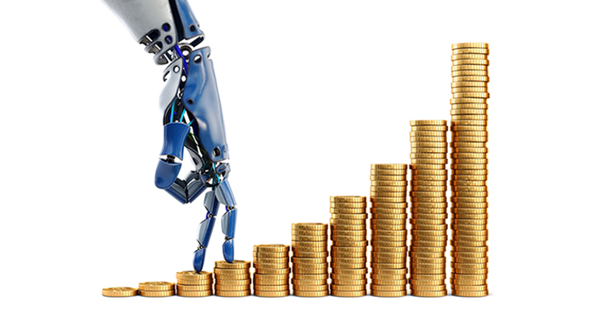
Compensation? Don’t discount it!

Slide 5
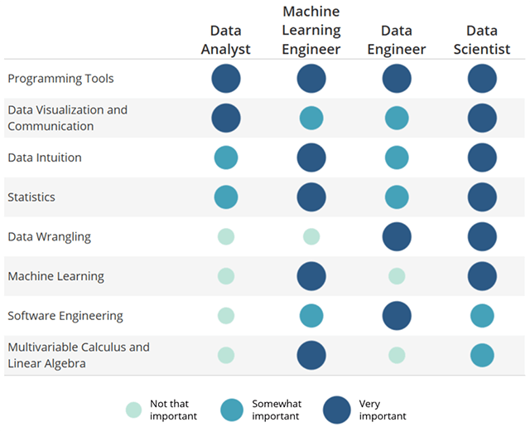
Learning? There’s Tons…

Slide 6

What about playing with powerful machines?
Like this one!
actually these ones…

Slide 7
Class 1: Outline
✔
Talking about machines…
Syllabus (On Canvas)
About you
About me
More on machine learning
Google Colab, notebooks, and Python
Lab 1
👈

Slide 8
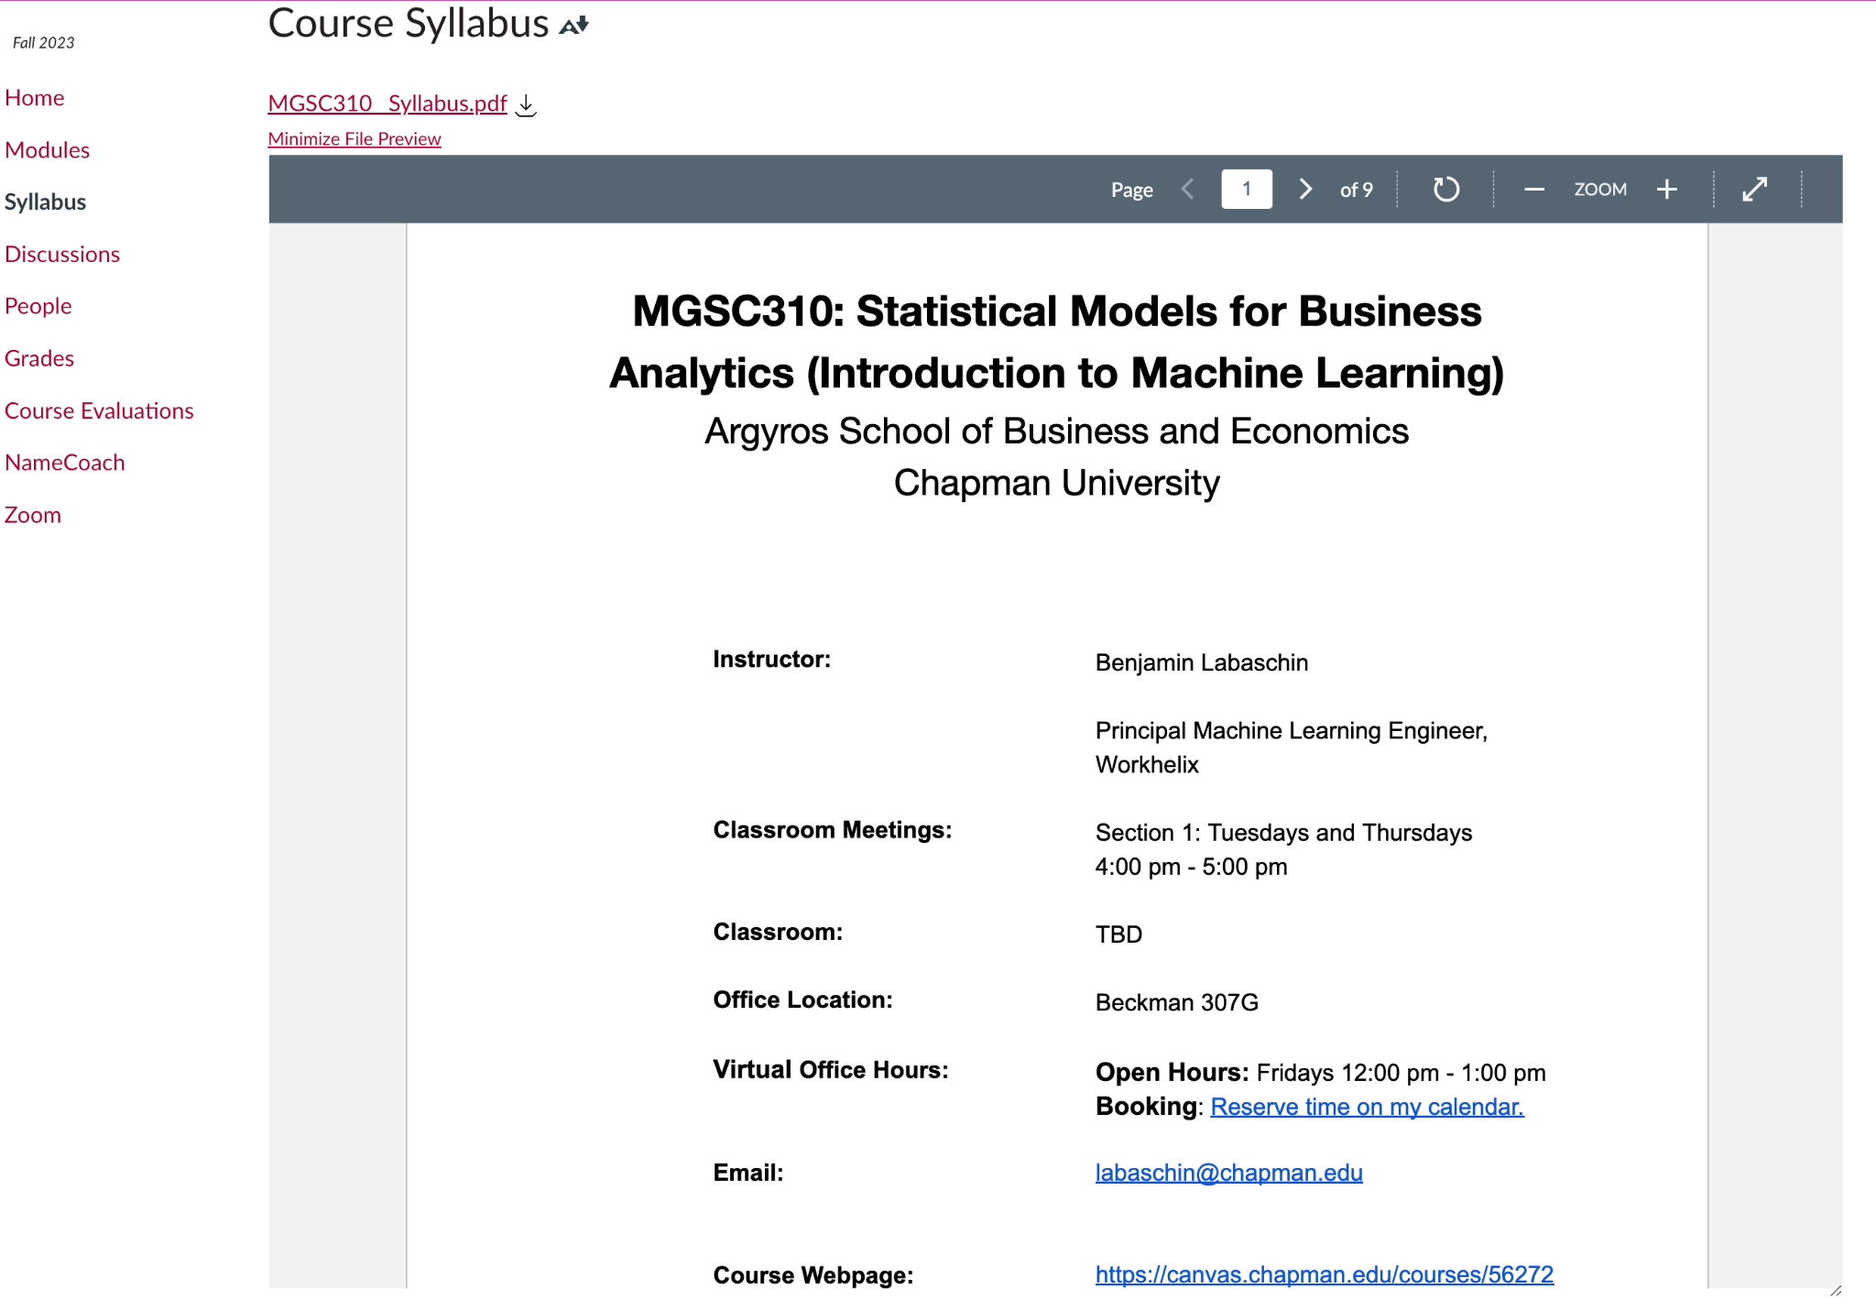
Syllabus on Canvas

Slide 9
Class 1: Outline
✔
Talking about machines…
Syllabus (On Canvas)
About you
About me
More on machine learning
Google Colab, notebooks, and Python
Lab 1
✔
👈

Slide 10

Notes:
Why are you taking this class?
https://PollEv.com/free_text_polls/aFY6ZxouLVd9AvAEEBsjW/respond

Slide 11
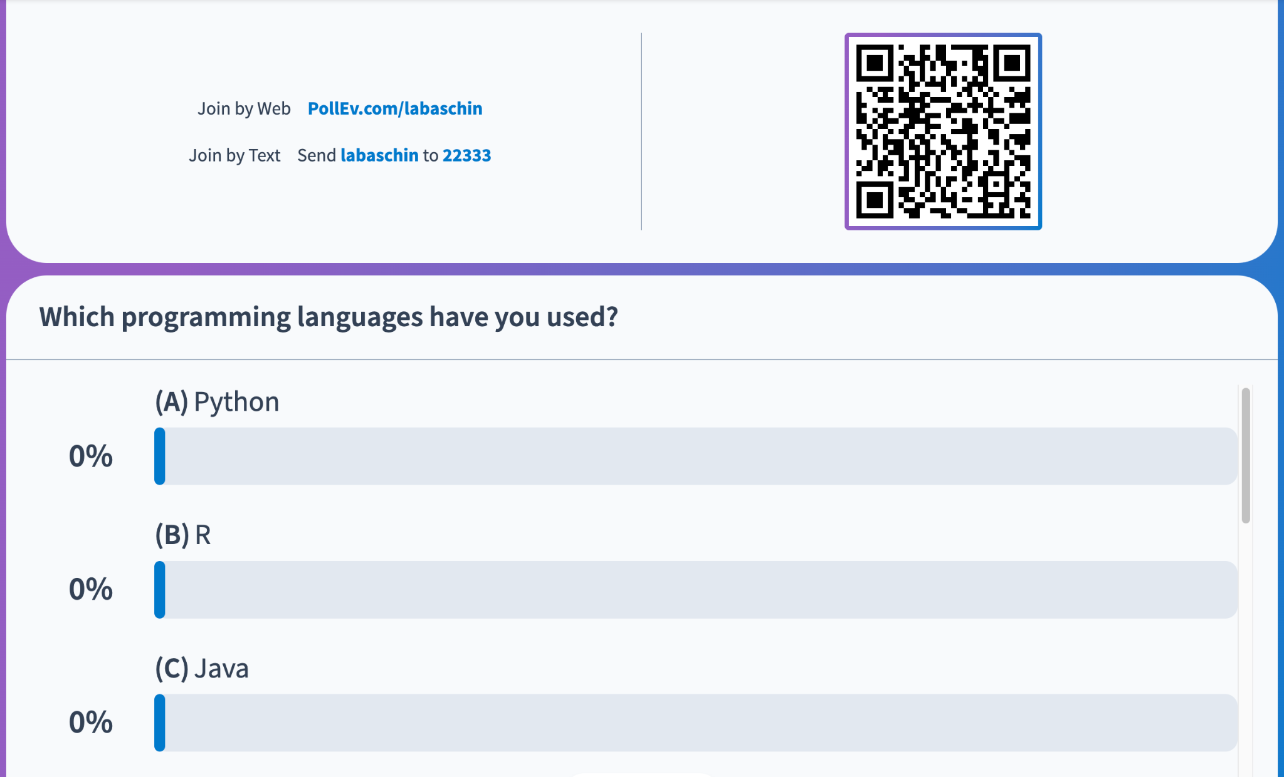
Notes:
Which programming languages have you used before?
https://PollEv.com/multiple_choice_polls/03NArhq56Dwj8GPImHUWt/respond

Slide 12
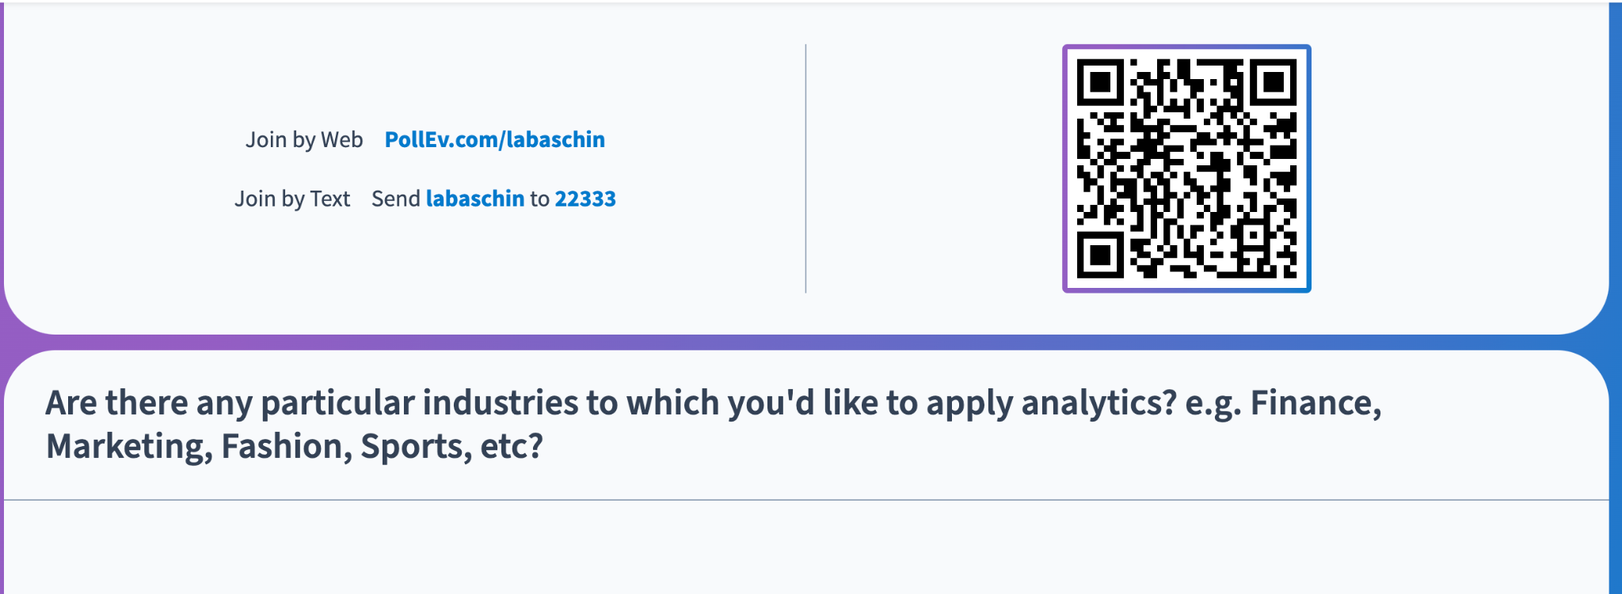
Notes:
Which programming languages have you used before?
https://PollEv.com/multiple_choice_polls/03NArhq56Dwj8GPImHUWt/respond

Slide 13
Class 1: Outline
✔
Talking about machines…
Syllabus (On Canvas)
About you
About me
More on machine learning
Google Colab, notebooks, and Python
Lab 1
✔
✔
👈

Slide 14

About Me
I like machine learning!
I like my family!
That’s me!
That’s Atlas!
I do machine learning!
I like playing with my dog!

Slide 15


Meet Atlas, Our Class Mascot
Best dog ever.

Slide 16
Class 1: Outline
✔
Talking about machines…
Syllabus (On Canvas)
About you
About me
More on machine learning
Google Colab, notebooks, and Python
Lab 1
✔
✔
✔
👈

Slide 17
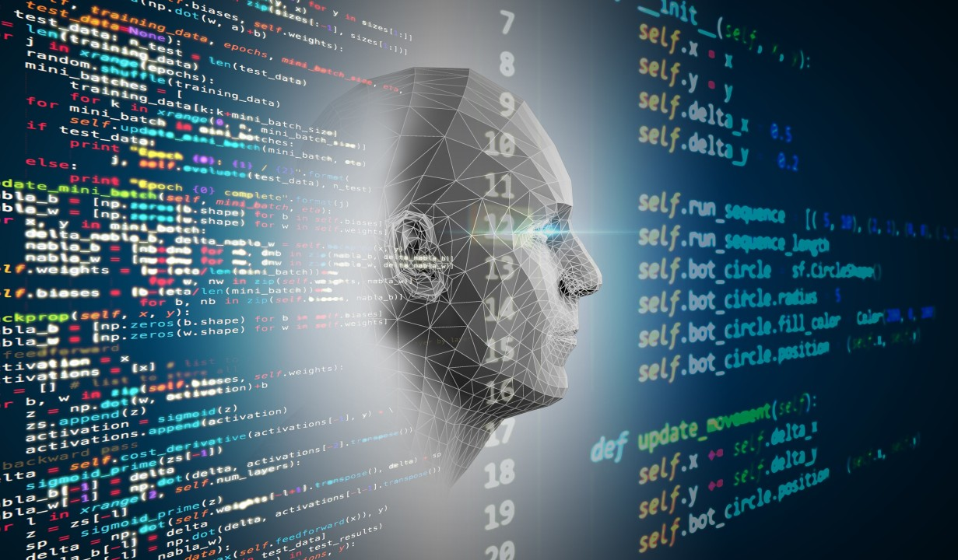
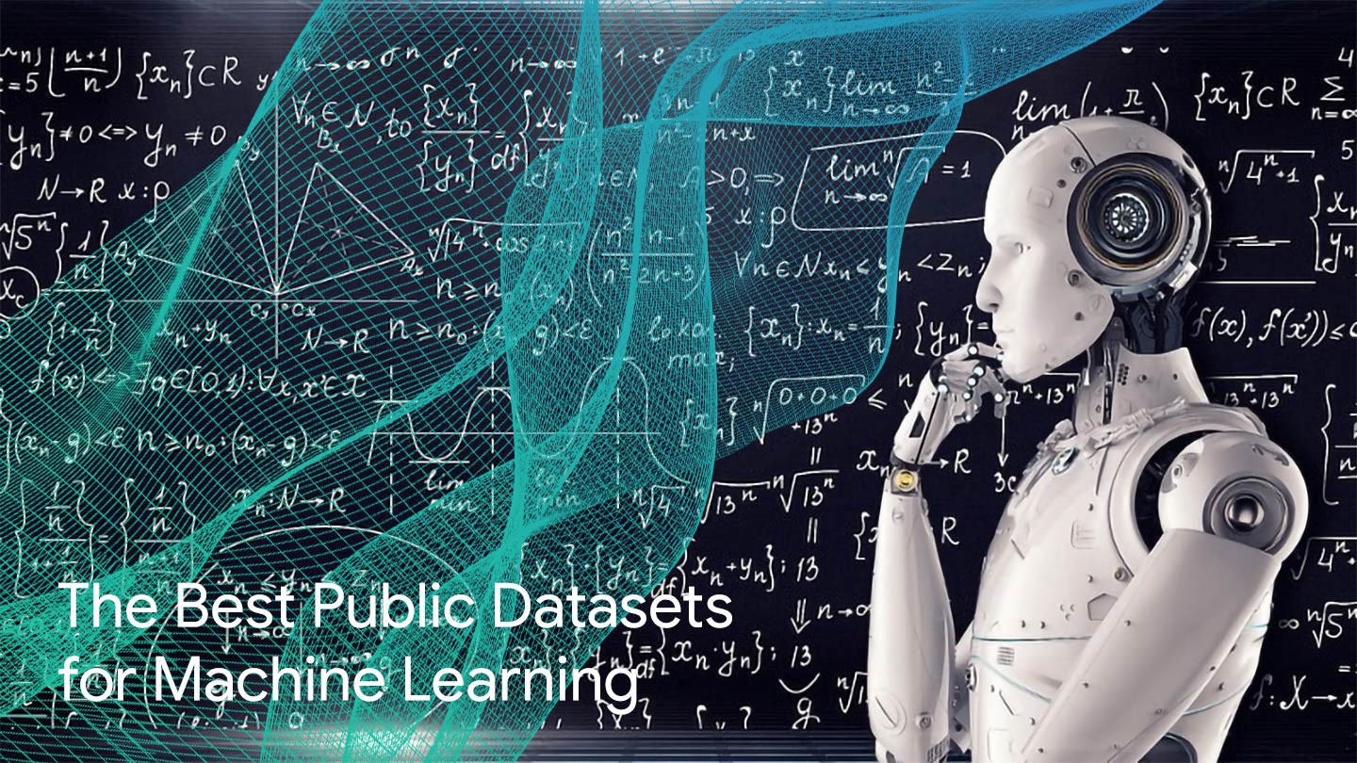
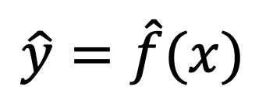
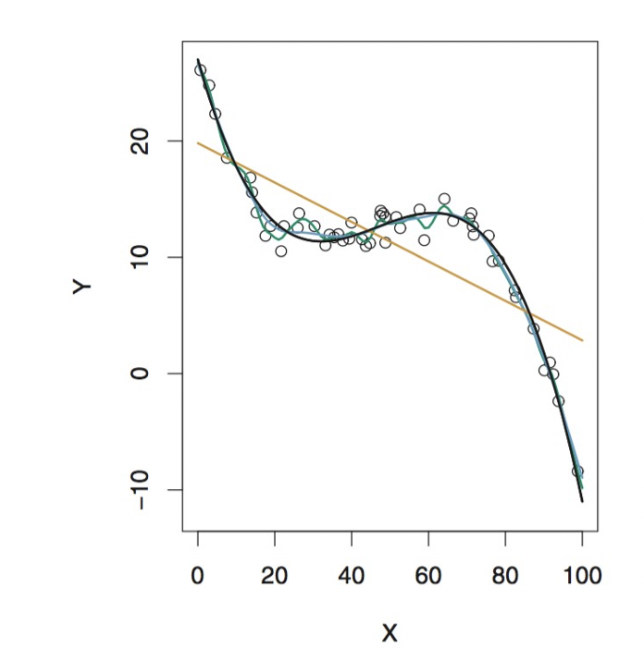

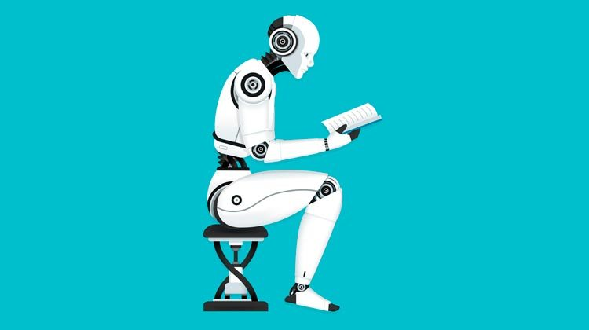
Public Conception of Machine Learning
Reality (90% of the time)
Target or Output
Input data

Slide 18
Machine Learning Versus Econometrics
Machine Learning
Developed to solve problems in computer science
Prediction/classification
Desire: goodness of fit
Huge Datasets! (Terabytes) Thousands of variables!
Whatever works
Econometrics
Developed to solve problems in economics
Explicitly testing a theory
“Statistical significance” more important than model fit
Small datasets Few dozen variables
“It works in practice, but what about theory?”

Slide 19
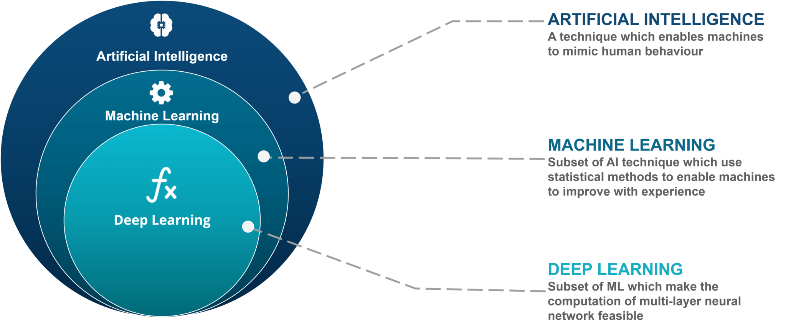
What is Machine Learning? What is Artificial Intelligence?

Slide 20
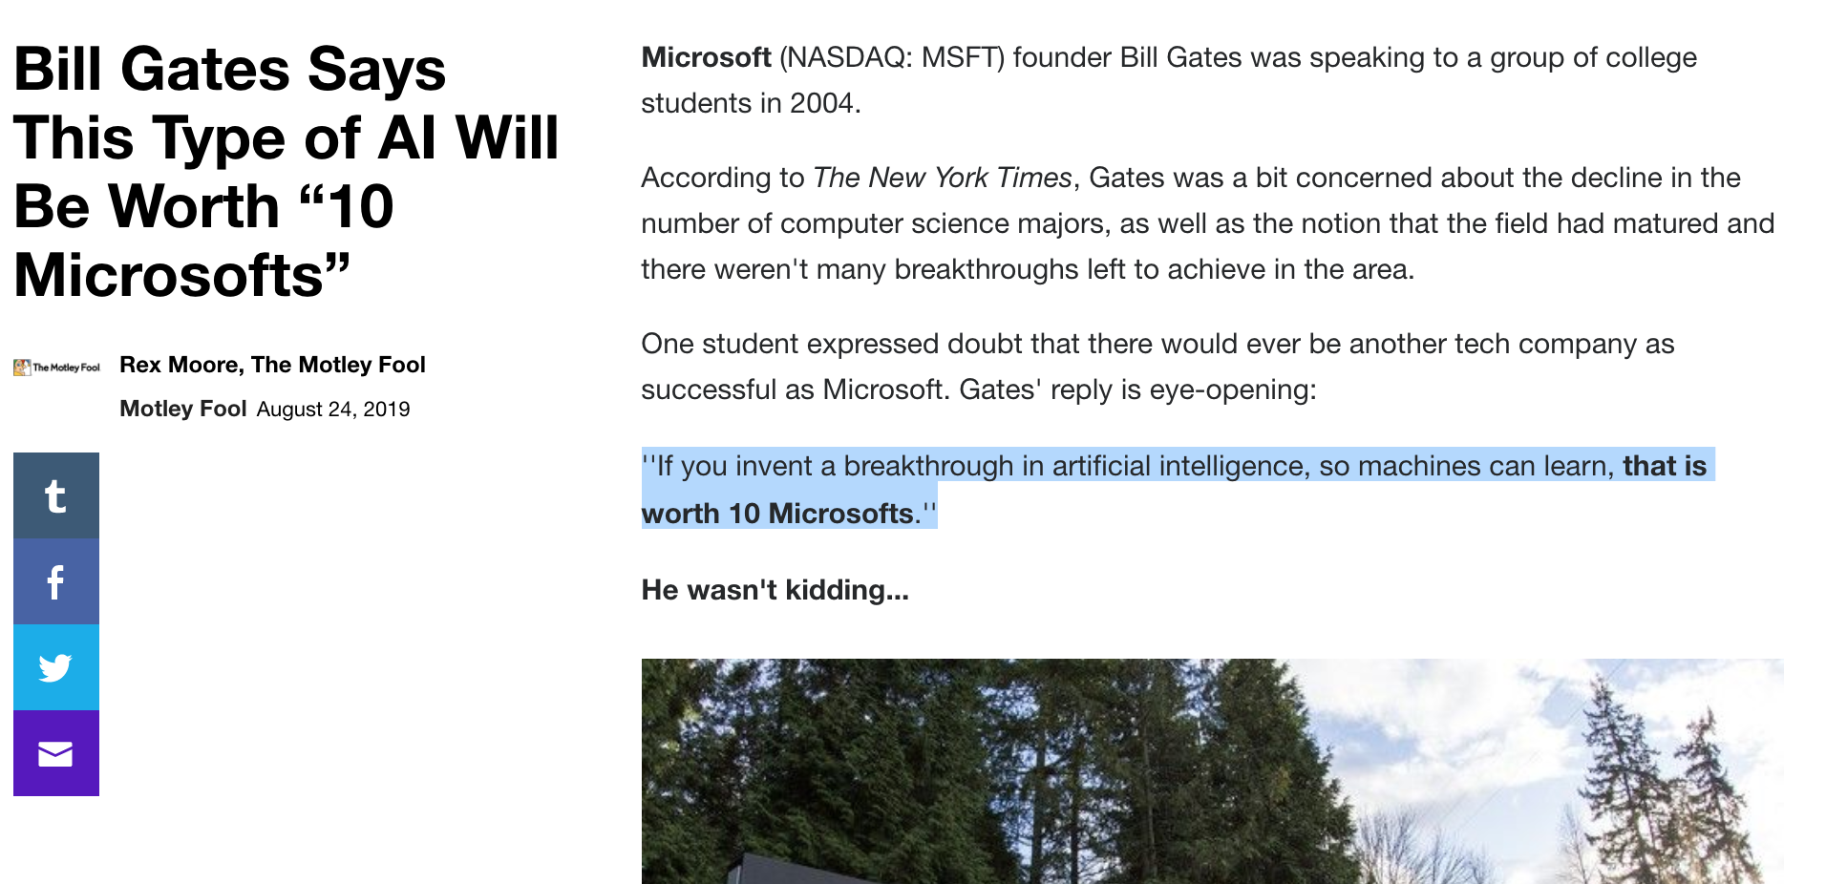

Slide 21
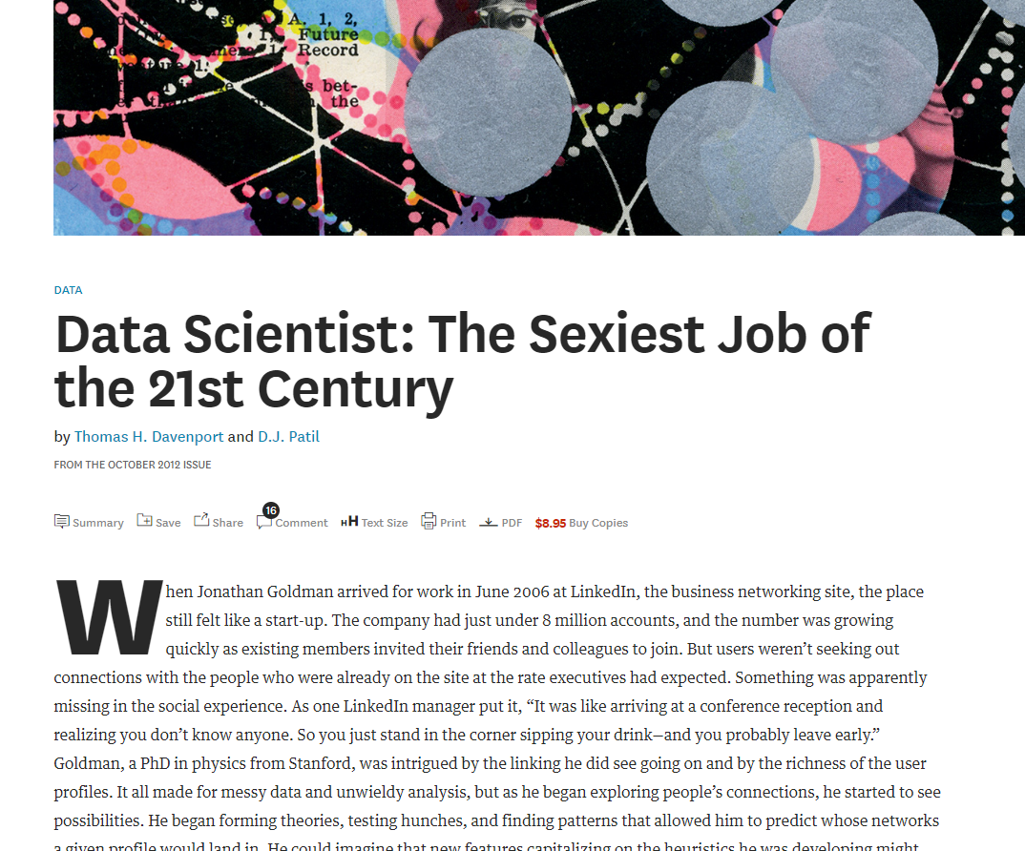

Slide 22
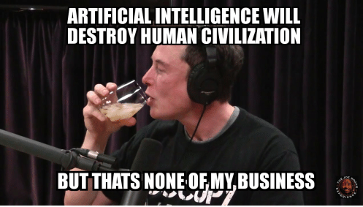

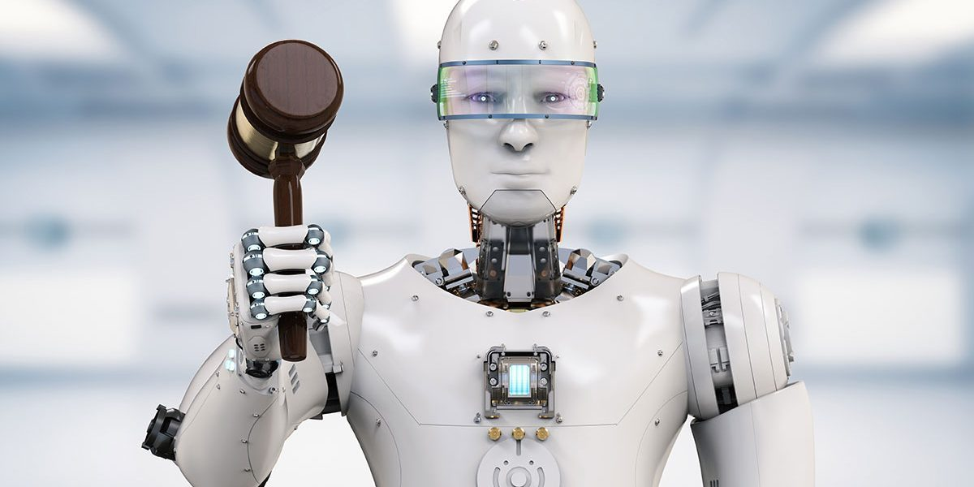

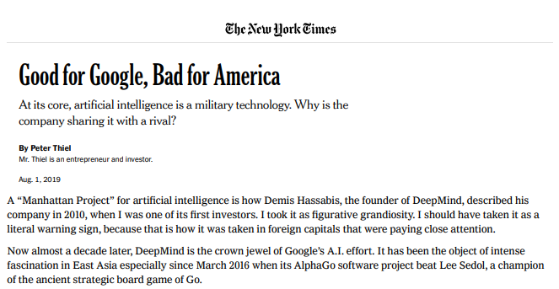
You can Help Answer: Policy Problems of AI/Big Data
We need a blend of humanistic and scientific understanding
Will AI Create or Destroy Jobs?
Is AI More or Less Biased Than Humans?
Unintended Consequences of AI
Can Privacy and Machine Learning Co-Exist?
Does AI Create an Unfair Advantage for Incumbents / Big firms?

Slide 23
Class 1: Outline
✔
Talking about machines…
Syllabus (On Canvas)
About you
About me
More on machine learning
Google Colab, notebooks, and Python
Lab 1
✔
✔
✔
✔
👈

Slide 24
A Note Before Getting Started with Google Colab…
Python dependency management sucks…
Without a controlled environment, we’d never get anywhere...
Google Colab will save you from future suffering, but you should rip that bandaid off eventually…

Slide 25

For now, we Colab!

Slide 26
Class 1: Outline
✔
Talking about machines…
Syllabus (On Canvas)
About you
About me
More on machine learning
Google Colab, notebooks, and Python
Lab 1
✔
✔
✔
✔
✔
👈

Slide 27
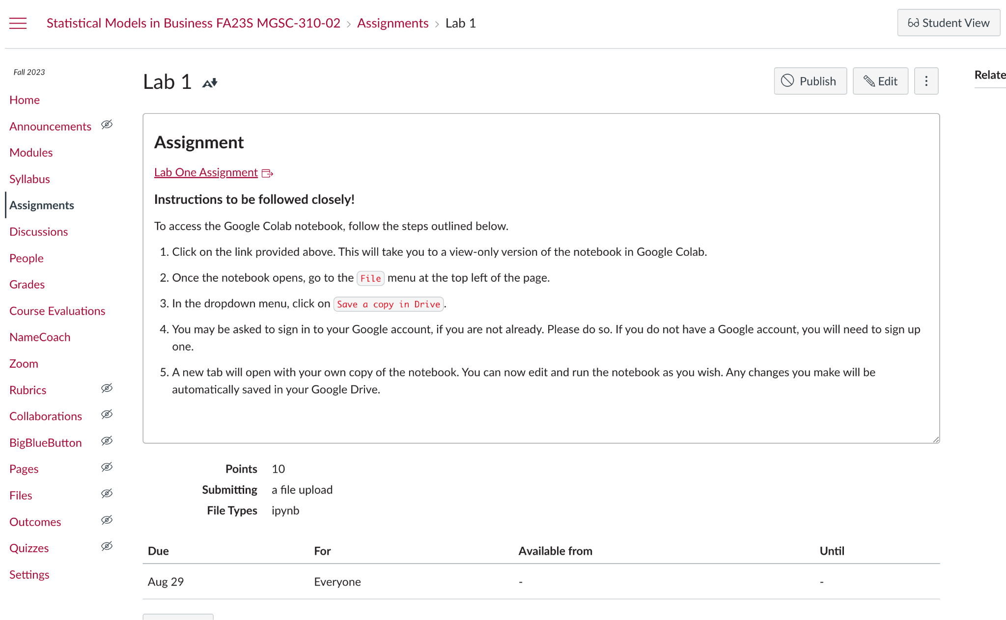
Lab Class 1

